Slide 1
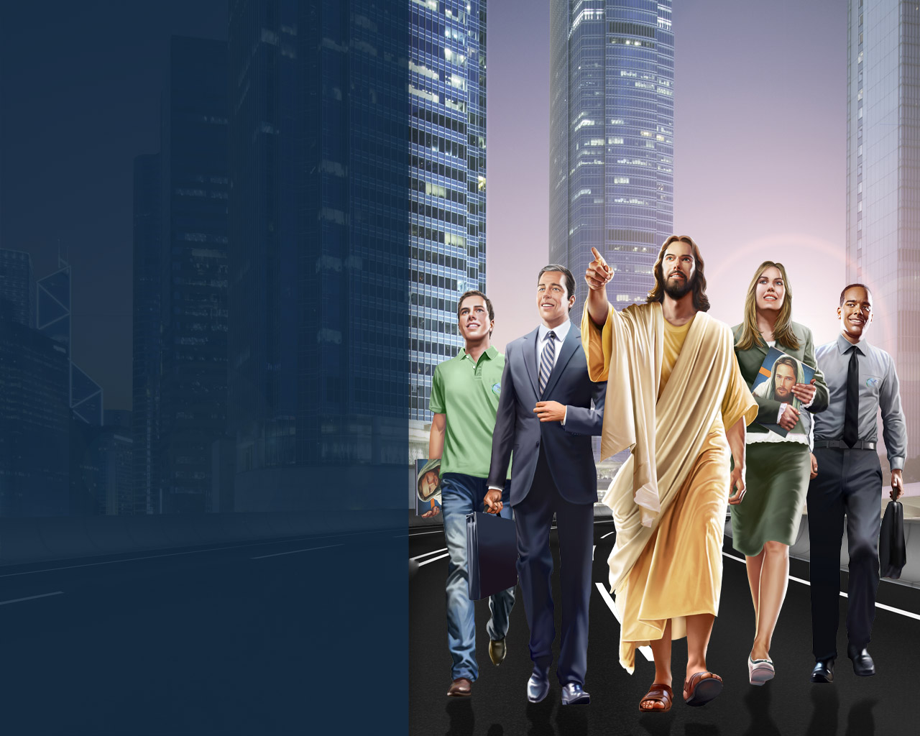
Sold or Sent
Almir Marroni
General Conference
Publishing Director

Slide 2
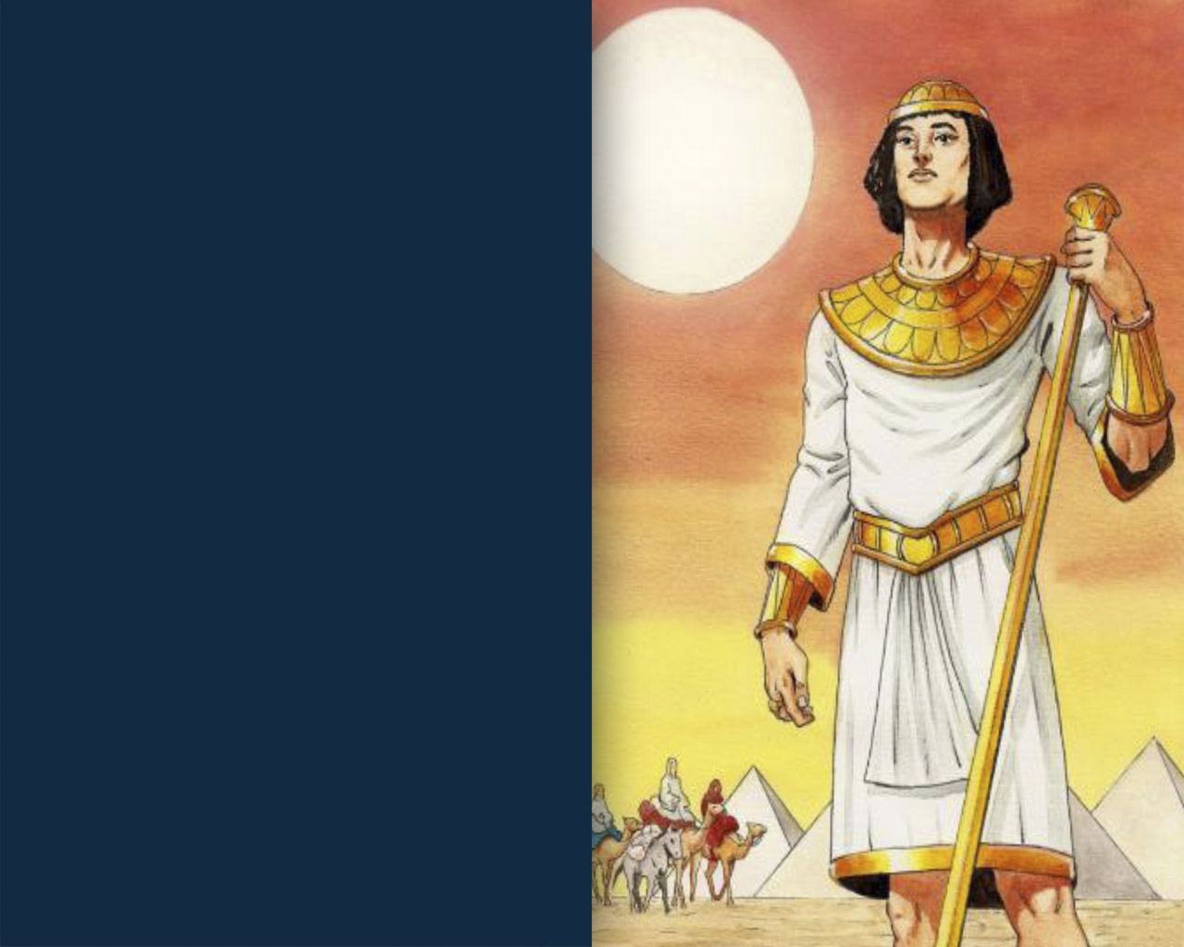
“And he sent a man before them—Joseph, sold as a slave. They bruised his feet with shackles, his neck was put in irons, till what he foretold came to pass, till the word of the Lord proved him true.”
Psalm 105: 17-19

Slide 3
There is a process that God takes us through

Slide 4

1
The person sent has a mission even before knowing what it is
(Genesis 45:5 - 8)

Slide 5
“And now, do not be distressed and do not be angry with yourselves for selling me here, because it was to save lives that God sent me ahead of you… But God sent me ahead of you to preserve for you a remnant on earth and to save your lives by a great deliverance. So then, it was not you who sent me here, but God. He made me father to Pharaoh, lord of his entire household and ruler of all Egypt.”
Genesis 45:5 a 8

Slide 6

2
The person sent undergoes a process of abandonment, pain, and loss.
(Genesis 37:23 - 28)

Slide 7
“So when Joseph came to his brothers, they stripped him of his robe...
and they took him and threw him into the cistern...”
Genesis 37:23 - 24

Slide 8
“So when the Midianite merchants came by, his brothers pulled Joseph up out of the cistern and sold him for twenty shekels of silver to the Ishmaelites, who took him to Egypt.”
Genesis 37:28

Slide 9
Joseph was deprived of precious possessions and was forced to resign
Father
Family
Home
Safety
Comfort
Friends
Advantages he had as favorite son
Freedom
Future

Slide 10
“You can measure a man by the opposition it takes to discourage him.”
Robert C. Savage

Slide 11

3
The person sent has their values tested.
(Genesis 39:7 - 10)

Slide 12
“and after a while his master’s wife took notice of Joseph and said, ‘Come to bed with me!’” Gen. 39:7
“How then could I do such a wicked thing and sin against God?”
Gen. 39:9

Slide 13
“Loyalty to values even when presented with suffering is a powerful incentive to character formation.”
John Ortberg

Slide 14

4
The person sent is interested in the well-being of others
(Genesis 40:6 - 7)

Slide 15
“Success depends not so much on talent as on energy and willingness. It is not the possession of splendid talents that enables us to render acceptable service; but the conscientious performance of daily duties, the contented spirit, the unaffected, sincere interest in the welfare of others” (Colporteur Ministry, p. 76).

Slide 16
Three secrets to Success:
Conscientious execution of daily duties,
A content spirit,
A sincere interest in the welfare of others.

Slide 17
“Christians who manifest a spirit of unselfish love for one another are bearing a testimony for Christ which unbelievers can neither gainsay nor resist”.
(Mind, Character, and Personality, vol. 1, p. 240).

Slide 18

5
The person sent is recognized as a man or woman of God.
(Genesis 41:38)

Slide 19
Evidence that Joseph was a man of God:
  1. Good reputation;
  2. Neat appearance;
  3. Wise words and advice.

Slide 20
How much would Joseph’s advice be worth if it could be given monetary value?

Slide 21
Joseph’s advice about business and economy made Egypt the most powerful country in the world, and Pharaoh the richest man in the world.

Slide 22
As drought severely intensified, landowners sold their properties in exchange for food, and Joseph purchased all the land in Egypt for Pharaoh.

Slide 23
In a way, the literature evangelist is similar to Joseph, but with one crucial difference:

Slide 24
While Joseph’s advice led to Egypt’s and Pharaoh’s wealth, the advice of a God’s servant will lead to the greatest of all treasures: Salvation!

Slide 25
While Joseph’s advice resulted in the preservation of life here on earth, a God’s servant advice will result in the preservation of life in eternity.

Slide 26

6
The person sent learns to forgive.
(Gênesis 45:5)

Slide 27
“And now, do not be distressed and do not be angry with yourselves for selling me here, because it was to save lives that God sent me ahead of you.”
Genesis 45:7

Slide 28

7
The person sent envisions eternity.
(Genesis 50:25 - 26)

Slide 29
“And through the centuries of toil which followed, the coffin, a reminder of the dying words of Joseph, testified to Israel that they were only sojourners in Egypt, and bade them keep their hopes fixed upon the Land of the Promise, for the time of deliverance would surely come”.
(Patriarchs and Prophets, p. 240)

Slide 30
Joseph survived his father by 54 years. He lived to see his grandchildren and great-grandchildren.
He witnessed the increase and prosperity of his people.

Slide 31
Throughout the years he remained committed in the faith that God would restore Israel to the Promised Land.
Even though he was prosperous and successful, Joseph understood that he was a foreigner in a strange land. His heart longed for the Promised Land.

Slide 32
Have we desired for the Home God is preparing for us?
Can something keep us here?
Are the traps of success and wealth holding us here?

Slide 33
“All that is not eternal is eternally useless.”
C.S. Lewis.

Slide 34

The Process that God takes us through:
The person sent has a mission even before knowing what it is;
The person sent undergoes a process of abandonment, pain, and loss;
The person sent has their values tested;
The person sent is interested in the well-being of others;
The person sent is recognized as a man or woman of God;
The person sent learns to forgive;
The person sent envisions eternity.

