Slide 1
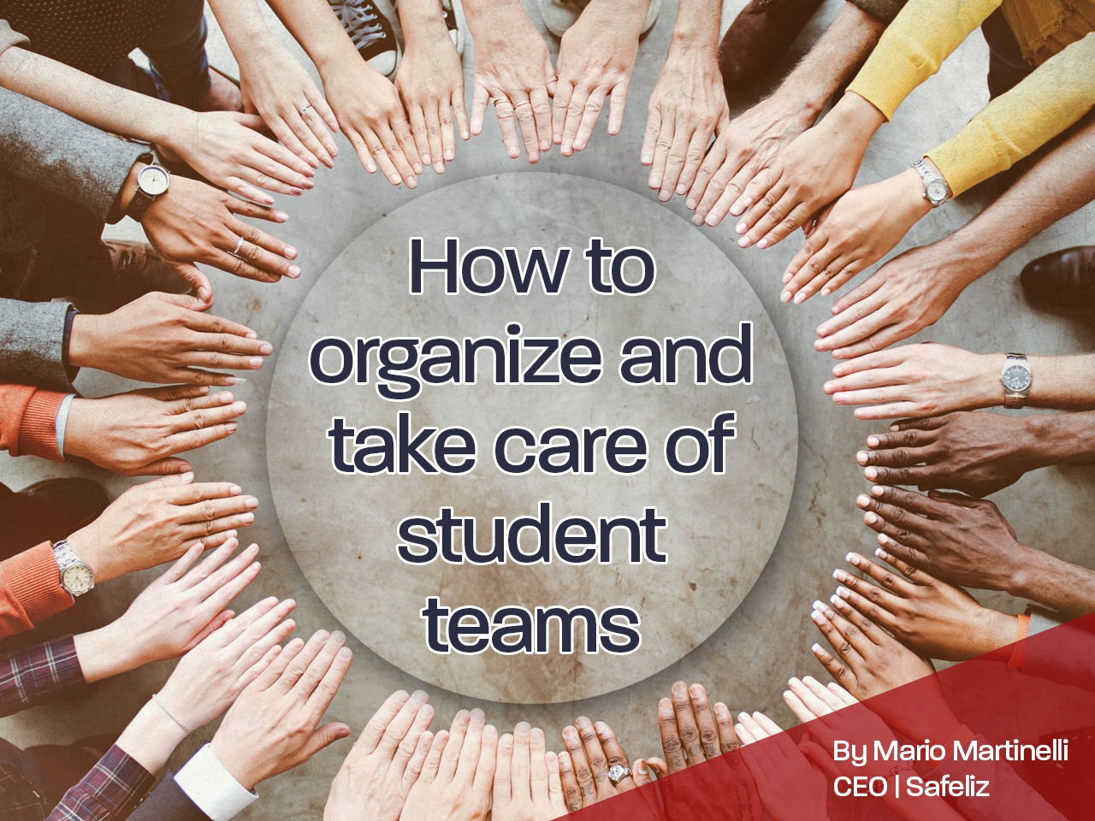

Slide 2
How to organize and take care of student teams
The organization of the student teams, the attention to the students and other details are crucial for a successful program
When proper planning and organization do not take place, problems happen, the canvassing work obtains a very bad reputation among the pastors and local churches, which not only dishonors God but brings discredit to the publishing ministry
When things are not properly organized and students are not properly assisted and taken care of, they have a bad experience and do not experience success. As a result, they go back to the campus and “bad-mouth” the canvassing work. With bad propaganda it becomes difficult to recruit and the work looses credibility

Slide 3
How to organize and take care of student teams
There are two important aspects to keep in mind when it comes to organizing student teams:
Arrangements and organization prior to the arrival of student teams
Organization and operations of student teams during a campaign

Slide 4
How to organize and take care of student teams
I - Arrangements and organization prior to the arrival of student teams
The publishing director (or one of his associates / assistants under his supervision) is responsible to make several arrangements and provisions before the student teams arrive and start canvassing. It includes but is not limited to: lodging, mattresses, provision of books and materials, promotional materials, some food (eventually), student´s meetings, etc.
All details and arrangements are important, but lodging in special requires very close attention and needs to be organized at least 2-3 weeks before students arrive

Slide 5
How to organize and take care of student teams
Lodging:
It´s important that the student team stays together in the same place
To lodge part of the team in one site and the other part in another site will be a challenge for the unity of the group and the leader will not be able to properly control and manage the team
The ideal is to have a team of women (and a woman as the leader) or a team of men (and a man as the leader)
The ideal is not to have a team of women and a team of a men working in the same city, even when the teams stay at different sites

Slide 6
How to organize and take care of student teams
Lodging:
Advantages of having a good lodging: the team will be more organized and efficient; the students will rest well and have good energy to work; the students will go back to school with a positive report; the image of publishing will be positive
The ideal is that the lodging can offer at least the following facilities: showers, sleeping rooms, kitchen and table for eating, a meeting room

Slide 7
How to organize and take care of student teams
Lodging:
There are three main possibilities in terms of lodging for the student teams:
In a church that has proper facilities (not very recommended)
In a school that has already facilities or can be adapted for such purpose
In a house / apartment or other facility that can be rented for this purpose (most recommended)

Slide 8
How to organize and take care of student teams
Lodging:
Important aspects to be taken into consideration:
Location – it needs to be centric or close to public transportation. When the lodging is too far from the city, students will loose too much time to go and come back from work
Environment – Students make noise. In addition, students will have worship, sing together and have other activities. Students also must rest and the lodging cannot be close by a noisy place. Thus, it´s very important to check the “environment” when choosing a facility
General aspects – Enough space, proper ventilation and illumination, enough water, faucets and shower facilities, among others, can contribute for the comfort of the students

Slide 9
How to organize and take care of student teams
Lodging:
Furnishings to be arranged for the lodging facility and students:
Mattresses for all students and the leader
Bunk beds
At least a small stove, microwave and some pans
A refrigerator
Table for eating
Chairs for the meetings
A separate room with a table for the leader and to keep inventory
Before students arrive these materials must be in place, so the leader and the students will not loose time with arrangements and will start to work immediately

Slide 10
How to organize and take care of student teams
I - Arrangements and organization prior to the arrival of student teams
Other arrangements:
Provision of books and inventory items in general
Package of promotional and work related materials for each student (price list, folders, prospectus, sales talk / canvass, initial inventory, etc.
Sales incentives
Food, such as molasses, oats, bread, fruits and others to support and motivate the students (if possible)
Special meetings for training and motivation

Slide 11
How to organize and take care of student teams
II - Organization and operations of student teams during a campaign
Student´s responsibilities:
Follow and abide by the policies established for the functioning and operations of the team
Respect and obey the leader
Respect the colleagues
Keep the personal belongings organized
Help with the responsibilities assigned and follow the suggested schedule

Slide 12
Student´s responsibilities:
Have a positive spirit to foster harmony and unity in the team
Attend the morning and vesper´s worships and seek a consecrated life
Work regularly during the established hours
Be on time
Make regular deposits with the leader of the cash received
Participate in all activities of the team including the ones related to the local church

Slide 13
How to organize and take care of student teams
II - Organization and operations of student teams during a campaign
Leader´s responsibilities:
Be spiritual and keep the mission focus of the canvassing work
Maintain the team under control and in good discipline and orderliness
Establish the policies and guidelines for the day to day activities of the team
Appoint students to coordinate the different areas of responsibilities related to the team (see below)

Slide 14
How to organize and take care of student teams
II - Organization and operations of student teams during a campaign
Leader´s responsibilities:
Lead the team and train and motivate the students (both technically and spiritually)
Divide and assign the territory to each student
Go out and canvass with the students in a fair and balanced way

Slide 15
Leader´s responsibilities:
Address the needs and watch for the well being of each student
Serve as the liaison between the students and the office / HHES
Make provision and order enough books and materials as sales progress
Control the inventory of books that each student receives
Receive the money from the students and make regular deposits to the office / HHES
Keep record of all business transactions and issue receipts (books given and money received) for all students
Be responsible for all books and materials ordered from the office / HHES and for settling the account at the end of the campaign
Serve as the liaison with the local pastor and church

Slide 16
How to organize and take care of student teams
The team and the different areas of responsibilities:
Student leaders must delegate to “key students” some of the tasks and routine activities related to the team. It´s like dividing areas of responsibilities in “departments”
These “key students” will serve as “sub-leaders” or “department directors” to coordinate several responsibilities such as: cleaning, spiritual activities, social activities and sports, church programs, etc.

Slide 17
How to organize and take care of student teams
The team and the different areas of responsibilities:
These sub-leaders / department directors will appoint students to perform the tasks, will prepare a schedule that includes everyone and will oversee the implementation of the schedule
The schedule with the list of responsibilities and corresponding names must be printed and displayed in a visible place

Slide 18
How to organize and take care of student teams
The team and the different areas of responsibilities:
Chaplain – in charge of worship (morning and evening). Director with daily schedule
Department of social activities – in charge of sports and social activities for the group (only for Saturdays after sunset and Sundays in the afternoon). Director and associate director for the entire period
Department of deacons / deaconesses – in charge of cleaning the restrooms, kitchen, meeting room, sleeping rooms, removing the trash, and everything that has to do with cleaning. Director with daily schedule with one person scheduled for each area

Slide 19
The team and the different areas of responsibilities:
Department of church activities – in charge of organizing the participation of the team at the local church (Sabbath school lesson, preaching, youth and full program, etc.). Director and associate director for the entire period
Department of music – in charge of leading the song service and organizing the music for church programs, etc. Director
Associate leader – is the second in command that should be trained to become a leader. Is also the person who is in charge when the leader is eventually away
Advisory committee – should be formed by the leader, the associate leader and the department directors. This committee could meet when needed to discuss matters of bad behavior, lateness, and other non-compliances issues with the purpose of applying certain discipline or even deciding on the termination of a student as part of the team

Slide 20
Conclusion:
Proper preparation and organization are crucial in order to have a successful student program with teams
When things are done in an organized way, students are not only successful and happy, but go back to school and influence others positively. Also, the image of the publishing ministry at the local church and on campus climbs and credibility grows
Every single detail counts. The organization of materials and the package students should receive upon arrival, a suitable lodging and a careful leader, along with proper incentives and the way the team is managed…all make a difference for the good

